Slide 1
Progress Report
Matt Chapman

Slide 2
Summary of past weeks:
Lots of settling in and setup
Development environment
Building familiarity with Buzzcapture codebase
Building familiarity with Buzzcapture products and harvested data
Additional research based on your suggestions
Papers from SIGKDD, SIGIR, ACL, WSDM and WWW

Slide 3
Summary of past weeks:
Build familiarity with data processing in Python:
Pandas, MatPlotLib, Numpy, etc
Handling of large data sources
Plotting and annotating data
Jupyter Notebook for annotated code
Exploring change detection algorithms:
See Buntain et. al & https://github.com/amanahuja/change-detection-tutorial

Slide 4
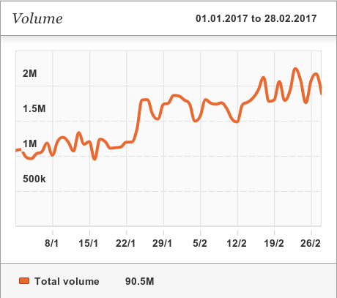
Summary of past weeks:
Choosing the dataset:
Starting point: 2 months of twitter posts

Slide 5
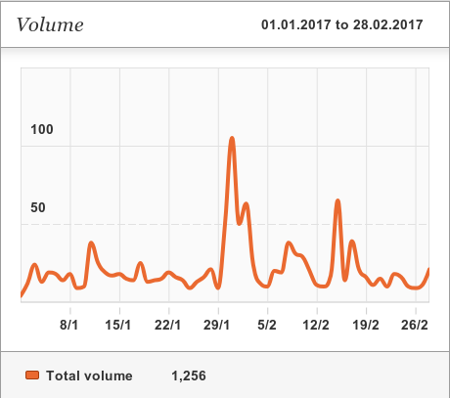
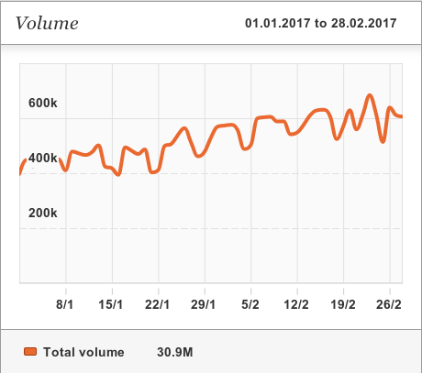
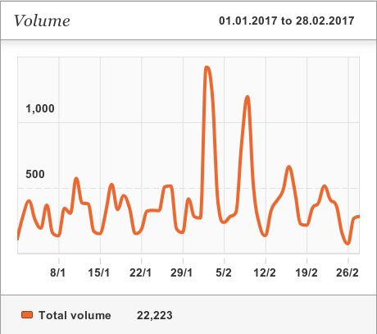
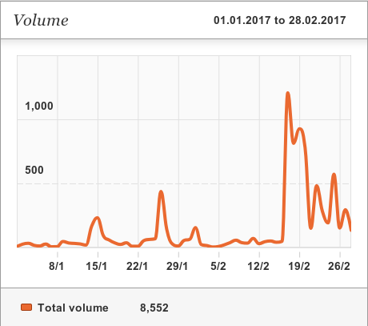
Summary of past weeks:
Reddit
Refine further
Limit language to Dutch
Rabobank
Unilever

Slide 6
Summary of past weeks:
Initial export of data done:
All Dutch twitter posts: 30.9M postings
Can import and query with Pandas to gain keyword specific postings
May do further exports from ElasticSearch to ease processing

Slide 7
This week:
Finishing a sprint story in the back-end dev team
Kingsday
Kingsday + 1

Slide 8
Short term goals
Refine hypothesis:
Hypothesis doesn’t provide any framework for novel experimentation
Way too general
Refine research questions:
I need to ask myself what I really intend to learn from this
I require sub-questions!
Get an algorithm implemented:
Plenty of resources out there to learn change detection algorithms
I need to spend a lot more time reading papers and learning the mathematical notation

Slide 9
Short term goals
Buzzcapture recently accquired by Obi4Wan
Moving to combined Zandaam office 1st July
Analytics team has some experience with change detection techniques
Will leverage that knowledge for thesis project

Slide 10
Next week:
Get hypothesis and research questions refined and documented
Start building the thesis document itself
Find at least two more relevant papers, start going through reading backlog
Bracket off a sprint for only thesis work
Start on framework for simulating incoming data

